Slide 1
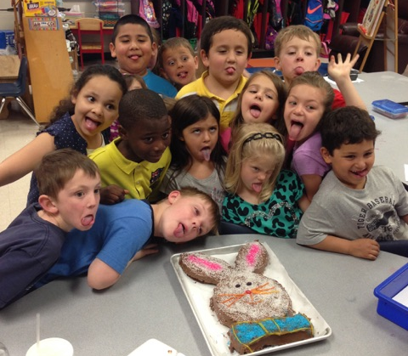
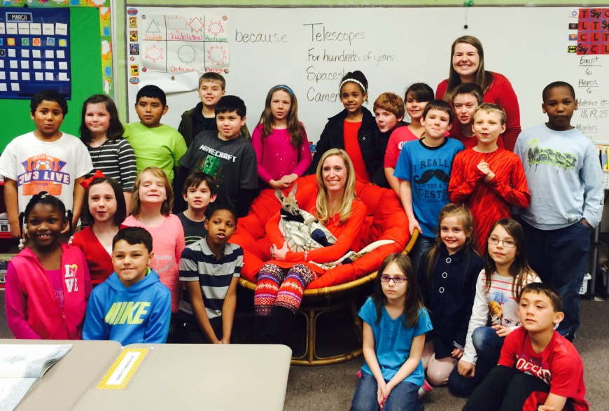
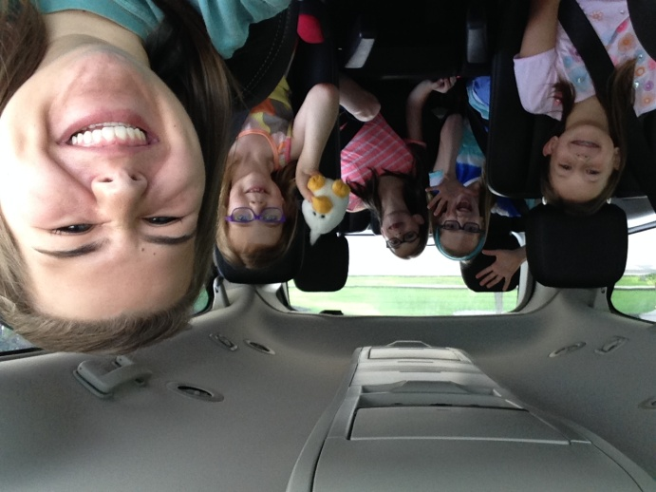
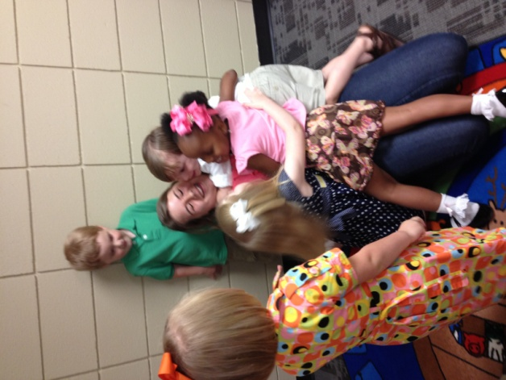
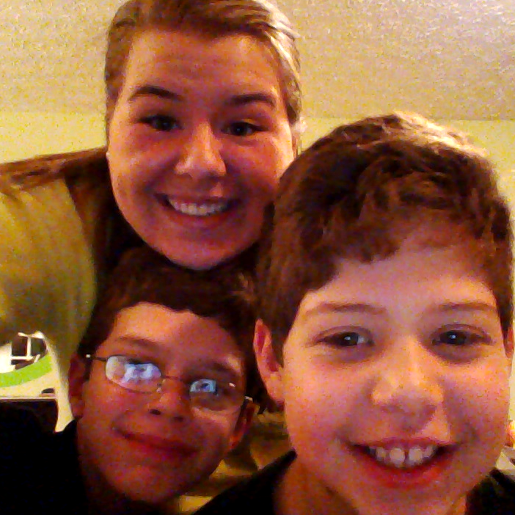
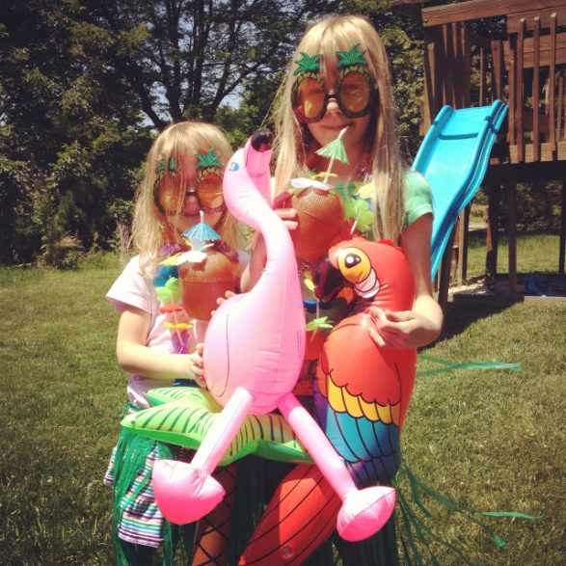
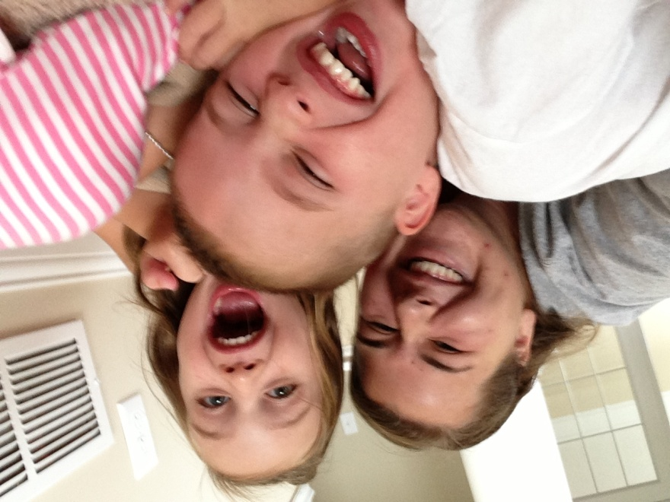
Evidence of Diverse Experiences
Harding University Spring 2015

Slide 2
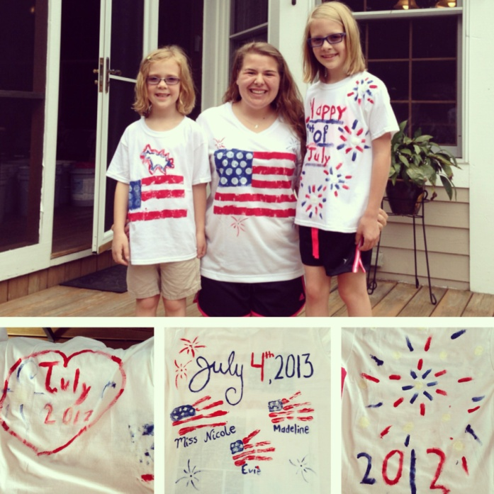
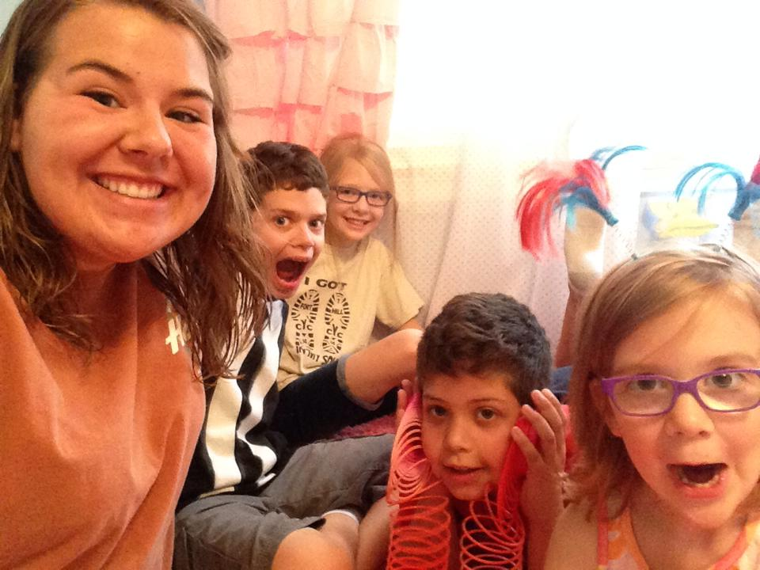
Knowledge of Child and adolescent Development
Since I was thirteen, I have babysat multiple families at my church. Two, in particular, I have gotten extremely close to, and have grown up with their children over the last couple years.
The Watson’s have two little girls, Madeline and Evie, and I have babysat them for the last three summers. When I first started, I mostly played games with them, but as they got older, I had the chance to teach them little things throughout the day. Now when I see them, I can’t believe how big they are getting, and how much they have grown – physically and academically.
The other family, the Osbourne’s, have two little boys, Cole and Joey. I have babysat these two throughout my years, and I’ve watched them grow up. When I was 17, Joey was diagnosed with Stage 2 Diabetes, and I had to learn how to give him insulin and take care of him – which I had never had experience with before. Now, Joey can give himself insulin, and Cole is reading two grades above level. I know that both of these families have grown up with great parents who have supported them in everything, and that is why they are successful.

Slide 3
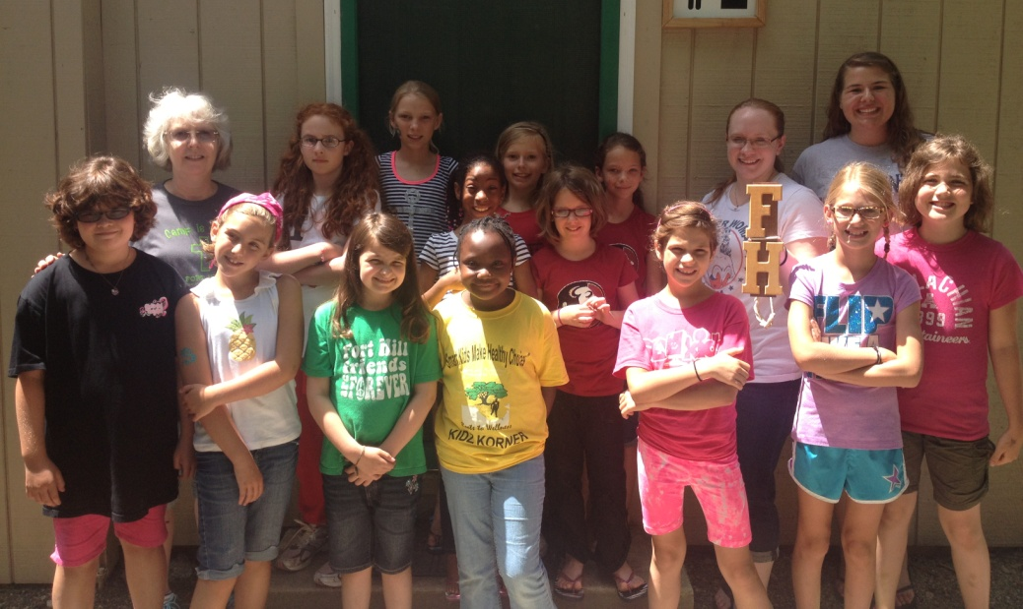
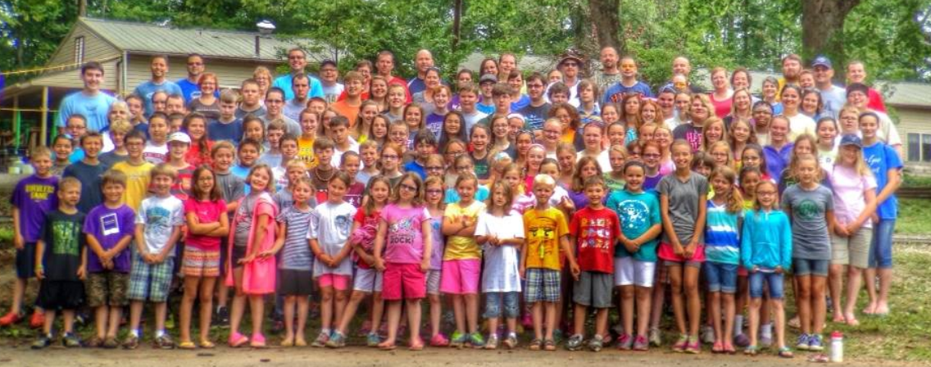
Knowledge of students interests and cultural heritage
For the past couple summers, I have volunteered at Fort Hill Christian Youth Camp in Hillsboro, Ohio. This is about three hours away from where my church is located, but a lot of our youth goes because our minister is the director of a week of camp. This is a great camp that allows students ages 5-18 to come for a week of worship with kids their age, and activities put on by the staff that volunteers there.
My church always has a big group that goes, but there is a vast amount of cultural differences at camp. Many of them, even though they are sent to a Christian camp, are not Christian or may not even go to church. Reaching out to these students is tough, but a lot of the time, us counselors try to find something that the kid likes so we can relate to them and draw them into our discussions with something they are interested in.
I have loved working at this camp because the kids come from all over Ohio, and it is such a way to branch out from the city that we live in and the people we interact with. This gives me a new perspective on those around me who quite possibly live a completely different life than I do.

Slide 4
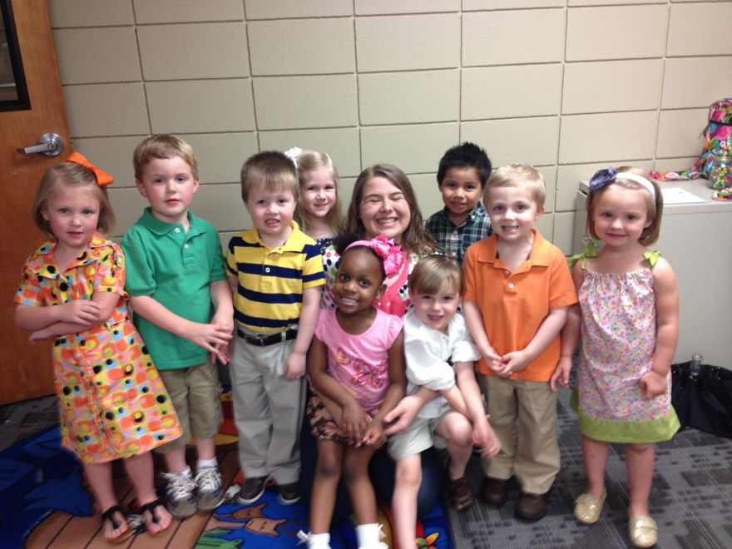
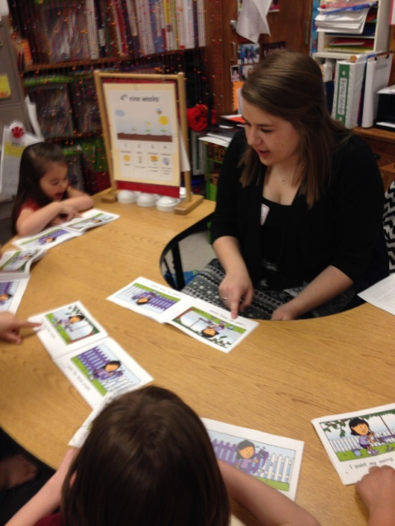
Knowledge of the learning process
For a semester during my Sophomore year, I was a teacher at Carpenter’s Kids. This was a preschool that met on Tuesdays and Thursdays at a church, and we would spend the morning teaching the children basic letters, numbers, colors, and about God.
I worked with ten three-year-olds, and we had activities, crafts, and games for them to play every day. Each day and each transition time was a learning experience for them, and I was so happy to be working with such sweet little kids to get them ready for pre-school.
This experience taught me what it was like to have to make a lesson plan, have to follow a strict teaching schedule, be flexible with my schedule, and monitor and assess.
I learned so much about teaching, and what kind of teacher I want to be when I have my own classroom. I also loved being able to see how the children were growing from day to day, and the kind of information that got sucked into their brain like a sponge.

Slide 5
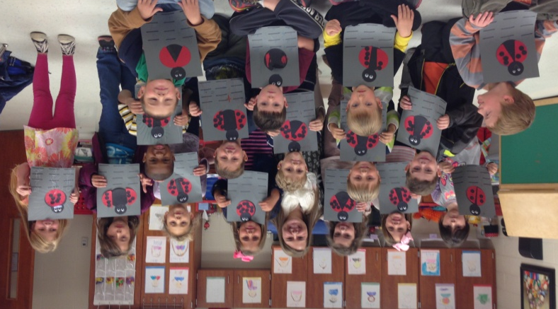
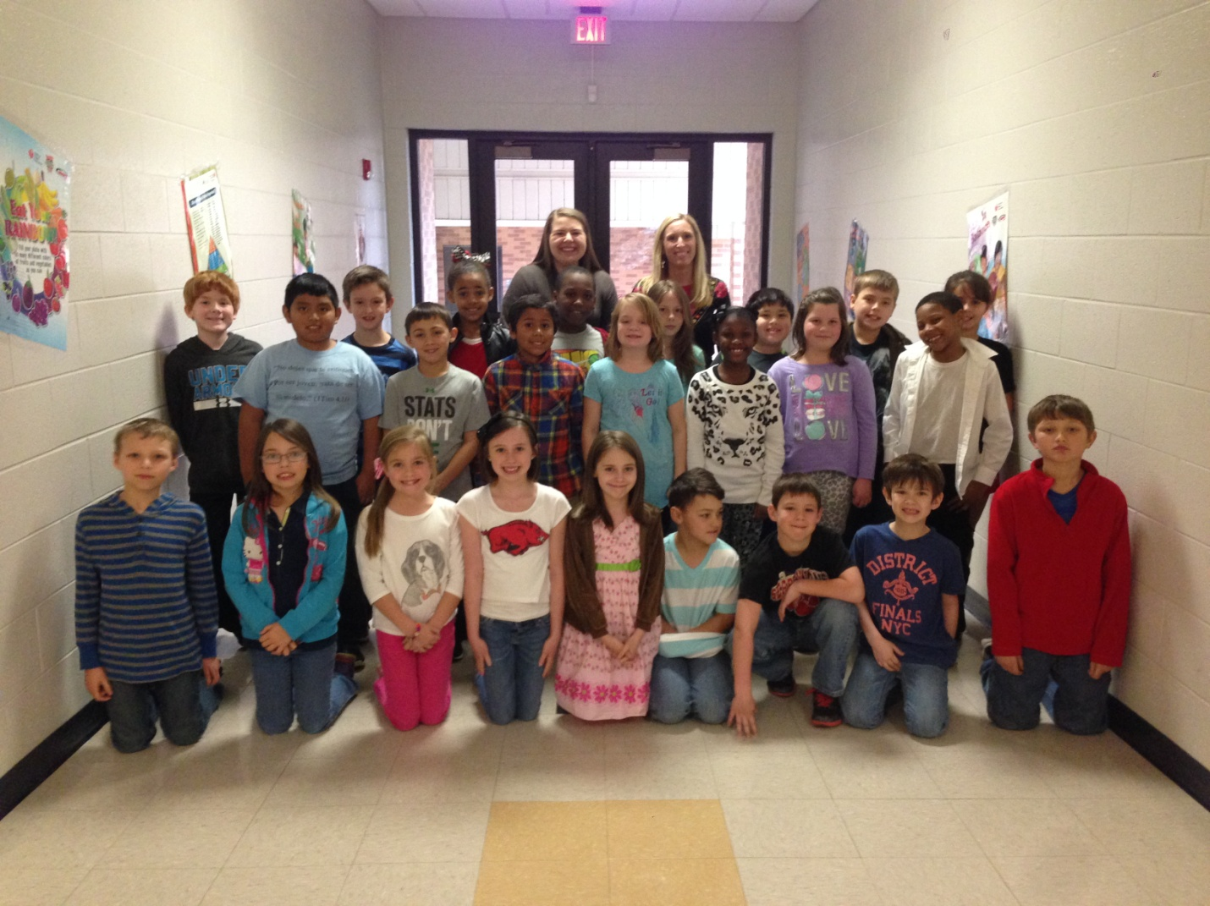
Knowledge of student’s skills, knowledge, and language proficiency
For Internship I, I was at Beebe Early Childhood, and for both placements in Internship II, I was at Searcy McRae Elementary.
Both placements were in small parts of town, and the children who went to them varied from “redneck” to “boutique” and everything in between. There are some parents who are fantastic and want to help with everything in the classroom. On the other hand, there are some parents who my teachers didn’t see from October to March because they never volunteered or came to the school to support their kid.
I worked very closely with both of these placements, and because of that, I have grown in my understanding of how a student’s brain works while experimenting with their skills and soaking up knowledge.

Slide 6
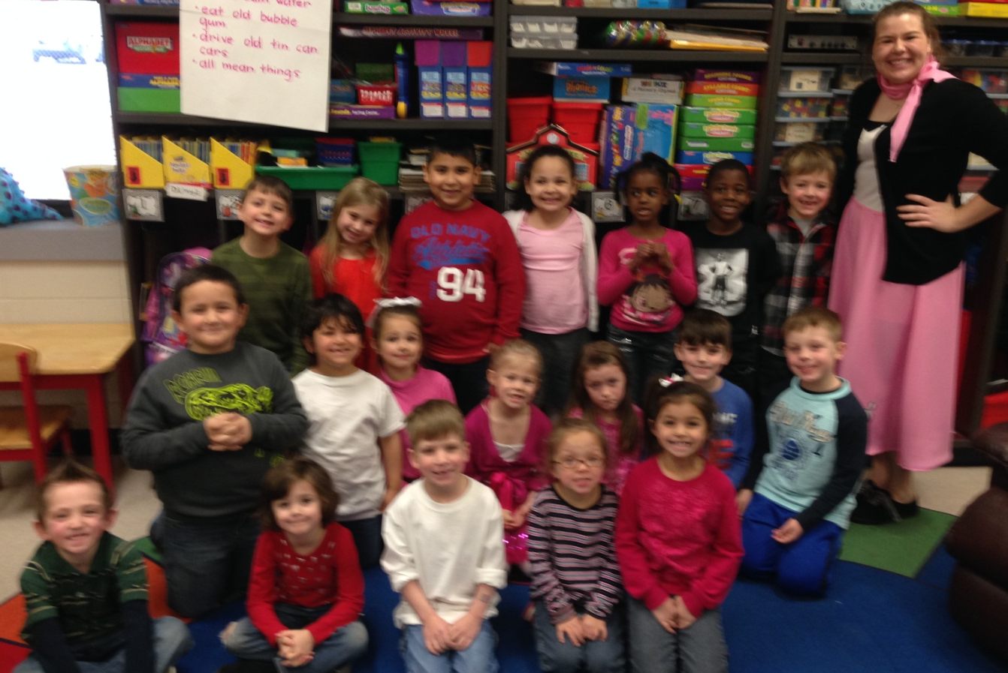
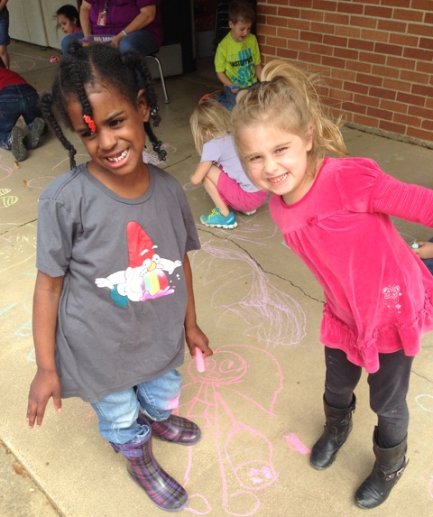
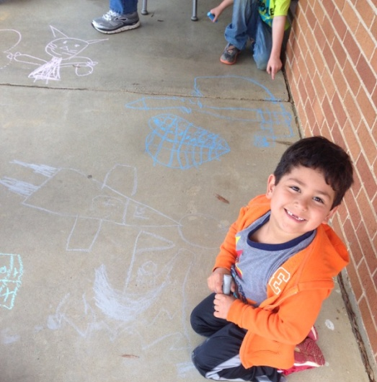
Knowledge of student’s special needs
At Searcy McRae Elementary, I was in Kim Rupard’s Kindergarten class for one of my placements. In Ms. Rupard’s class, she has five students who go to special Education classes every day, and about seven other students who go to some type of therapy more than twice a week. That is twelve out of her twenty students who struggle with something in their learning, and they are placed in classes to help them try to maintain their problem.
From being her student teacher, I have learned a voluminous amount of ways to engage students with special needs, and to modify and adjust my lesson plans to cater to every student in a way that will benefit them.

