Slide 1
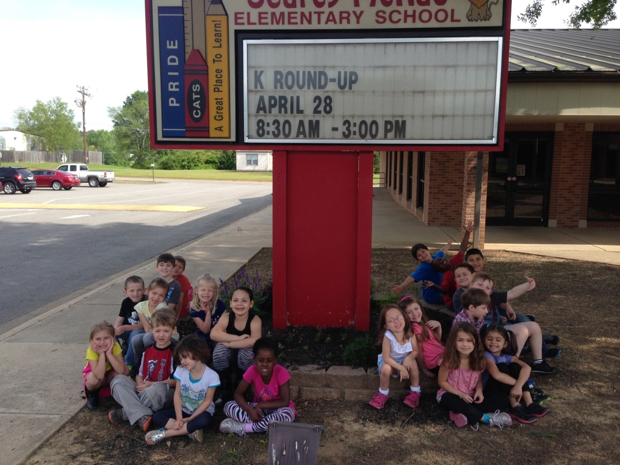
Evidence of Student Learning
□ Nicole Langlois □ SPED 419 □ Spring 2015 □

Slide 2
Congruence with Instructional Outcomes
□ Danielson 1f
CCSS.ELA-LITERACY.RF.K.1.C
Understand that words are separated by spaces in print.
CCSS.ELA-LITERACY.RF.1.2.D
Segment spoken single-syllable words into their complete sequence of individual sounds (phonemes).
CCSS.ELA-LITERACY.L.2.4.D
Use knowledge of the meaning of individual words to predict the meaning of compound words (e.g., birdhouse, lighthouse, housefly; bookshelf, notebook, bookmark).
Lesson
“Chopping it out”
Learning Page

Slide 3
Design of Formative Assessments
□ Danielson 1f
I decided to assess my students in three different ways. I observed them as I taught and as they worked on their learning pages. I also was questioning to see what they knew, and at the end I asked them to give me a thumbs up for “got it”, thumbs sideways for “almost there”, and thumbs down for “I need some practice”. The final way I assessed my students was by collecting their papers and seeing who could think of a compound word that was not already on the paper.

Slide 4
Criteria and Standards Danielson 1f
Formal: the learning page I collected was a way to see what the students understood about the lesson, and if they were able to do it at their level.
Informal: I was observing while they were working on their learning pages, and when they had a question I made a note of whether it was developmental or lack of subject knowledge.
Questioning: I used questioning in my lesson to see if they were capable of understanding the topic. I also asked them to give me a thumbs up if they understood it, a thumbs sideways if they got about half of it, and a thumbs down if they were having trouble.

Slide 5
Maintaining Accurate Records
□ Danielson 4b

Slide 6
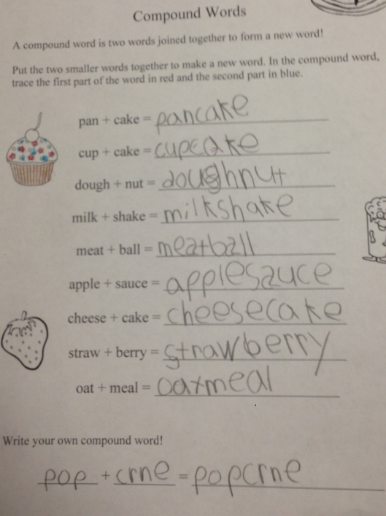
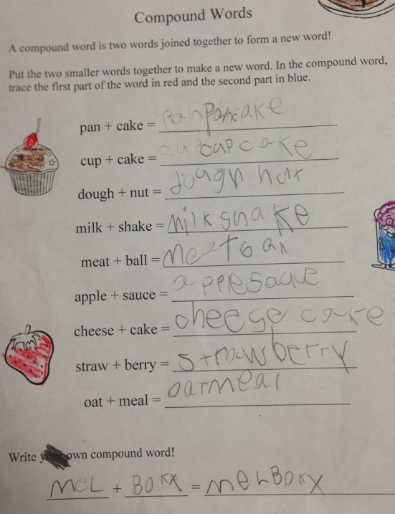
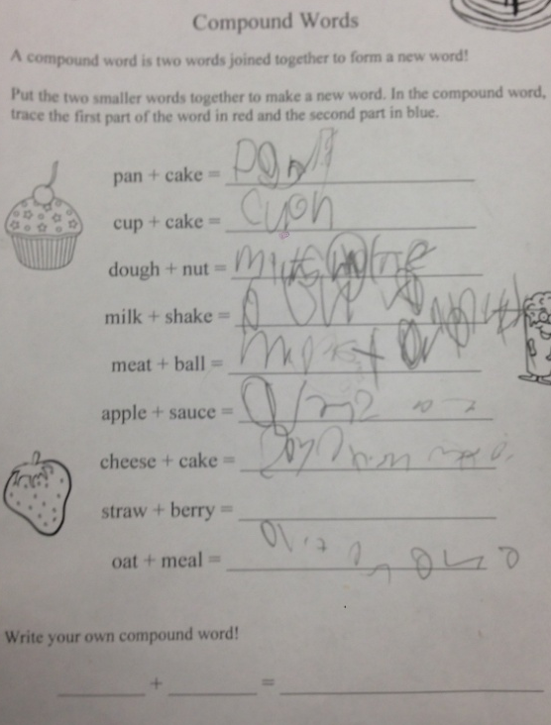
Samples of Student Work
Student A Student B Student C
□ Student A is one of the top students in my class. They are in my top reading group, and always has something to contribute to the conversation. Student B is a middle-level student. They get the idea, but they are not able to pick up on it immediately. Student C is not in Special Education, but they are in the lowest reading group. They dilly-dally and goof around instead of doing their work – even though they have the potential to be very smart.

Slide 7
Student Self Assessment
  After asking about their compound word:
Student A – “I thought of popcern, watermelon, beachball, toothfairy, gummies (‘gum’-‘me’s), and mirror (‘me’-‘roar’). Can I help (another student)?”
Student B – “I know mailbox is a compound word!” (We did a compound word game the day before, and that is the one she remembered)
Student C – “I don’t know what that means.” “I don’t know how to do this.”

Slide 8
Use for planning Danielson 1f
From all of my assessments, I have gathered that this subject content might be a little advanced for some of my students. It was a second grade standard, but I thought I could present it in a way that they would be able to understand it, and if anything it would front-load them for when they would eventually learn it. Many of them understood the concept of two words combining to make a completely new one, and that word having a completely different meaning than just combining the two words (i.e. not a cake made of cheese), but they were not effectively able to discover a multitude of compound words on their own.

Slide 9
Analysis and Evaluation of Learning
INTASC 8.
I believe that a majority of my class understood at least part of this lesson, but the ones that didn’t quite grasp it are so close. I think providing more visuals to show them the actual separation of the two words in a compound word would’ve been more beneficial than writing it on the white board.
I would teach this lesson again, but I would probably teach it in first grade since the students who understood this assignment were on the older side of the spectrum.

